Slide 1

Design Thinking for Cloud and Edge Computing
This presentation explores how Design Thinking can be applied to create innovative solutions in the fields of Cloud and Edge Computing.
Done by : Group 2
Muhammed Usman | A23MJ3008
Hassan Saad | A23MJ3005
Abdulrahman Barghout | A23MJ4014
Abdul-Rahman Siad | A23MJ3061
Kahlan Sultan | A23MJ4021

Slide 2
Understanding User Needs
Empathy
Example
Design Thinking emphasizes understanding user needs. This involves conducting user research through interviews, surveys, and case studies to identify pain points and challenges.
For Cloud and Edge Computing, this might involve understanding the challenges faced by businesses, healthcare providers, or IoT developers.

Slide 3
Defining the Problem
Once user needs are understood, the next step is to clearly articulate the problem your Cloud and Edge Computing innovation aims to solve.
A well-defined problem statement provides a clear direction for the design process.

Slide 4
Generating Creative Solutions
1
Brainstorming
2
Examples
Use brainstorming techniques to explore innovative ideas that enhance Cloud and Edge Computing.
This might involve exploring ideas like AI-powered frameworks for optimizing cloud-edge data transfer or tools for secure and seamless synchronization between cloud and edge environments.

Slide 5
Creating Early Models
Develop prototypes to test ideas quickly and cost-effectively. Prototypes can be simple mockups or functional models that demonstrate key features.
This allows for early feedback and iteration before investing significant resources.

Slide 6
Gathering Feedback and Iterating
Test prototypes with real users to validate their effectiveness. Collect feedback on performance, usability, and security features.
Use this feedback to refine prototypes and iterate on solutions to ensure they meet user needs.

Slide 7
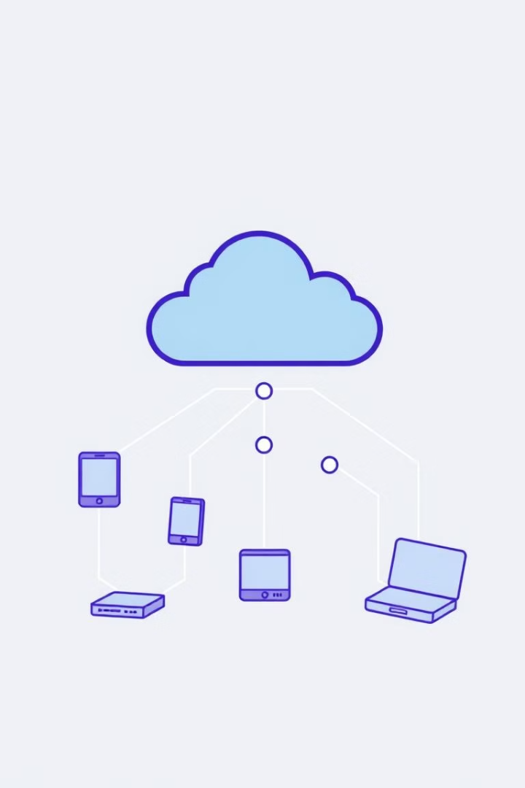
Addressing Challenges in Cloud and Edge Computing
Latency Issues
Integration
Edge devices often face delays in real-time data processing, which can impact performance and user experience.
Ensuring seamless coordination between edge devices and centralized cloud systems can be complex, requiring careful planning and management.
Security and Privacy
Transferring sensitive data between cloud and edge environments introduces vulnerabilities that must be addressed with robust security measures.

Slide 8



Innovative Solutions for Cloud and Edge Computing
Hybrid Data Processing Systems
Intelligent Edge AI Models
Deploy real-time decision-making systems on edge devices, reducing reliance on cloud connectivity.
Combine cloud scalability with edge speed for industries like healthcare and manufacturing.
Security-First Platforms
Design architectures with built-in encryption and robust data protection protocols.

Slide 9
Key Takeaways
Design Thinking provides a structured approach to developing user-centered solutions for Cloud and Edge Computing.
By prioritizing empathy, collaboration, and continuous improvement, we can create innovations that are not only technically advanced but also meaningful and accessible.

